Slide 1


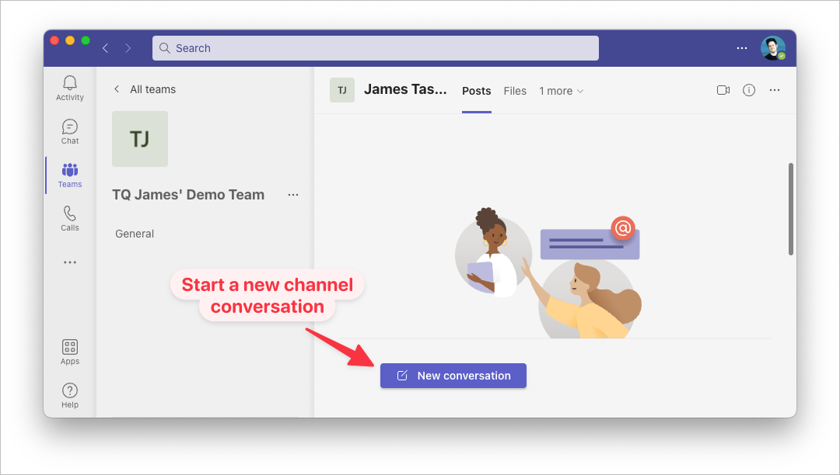
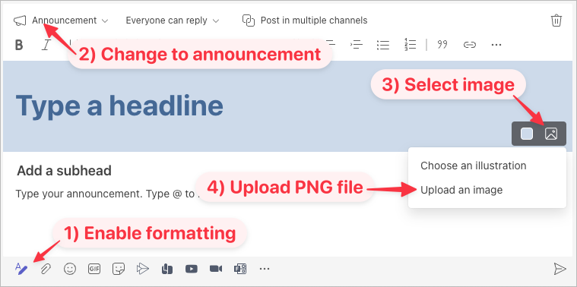
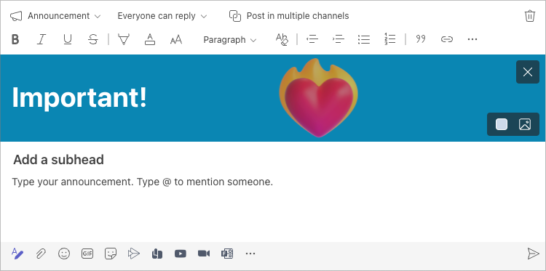
Teams Announcement Banner Template
1) Put everything you want visible in the blue rectangle below. Change the background, if you like.
2) Once added, export this slide as an image (PNG). [Show me how]
3) Go to Teams & make a new announcement in a channel. [Show me how]
4) Find the saved PNG file and add it as an image. Teams will crop out these instructions & leave you with a great-looking announcement banner!

